Slide 1

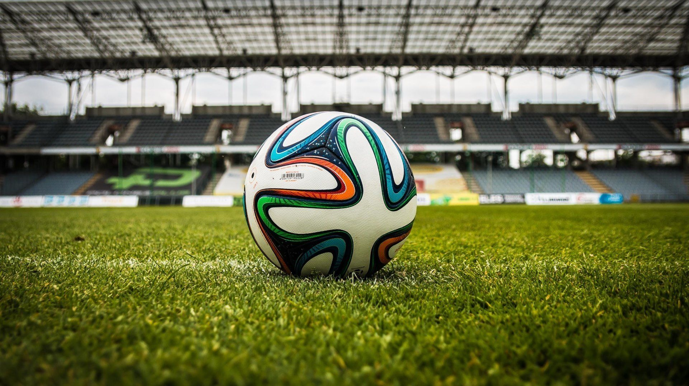
Football Match Probability
Richard Ahn

Slide 2
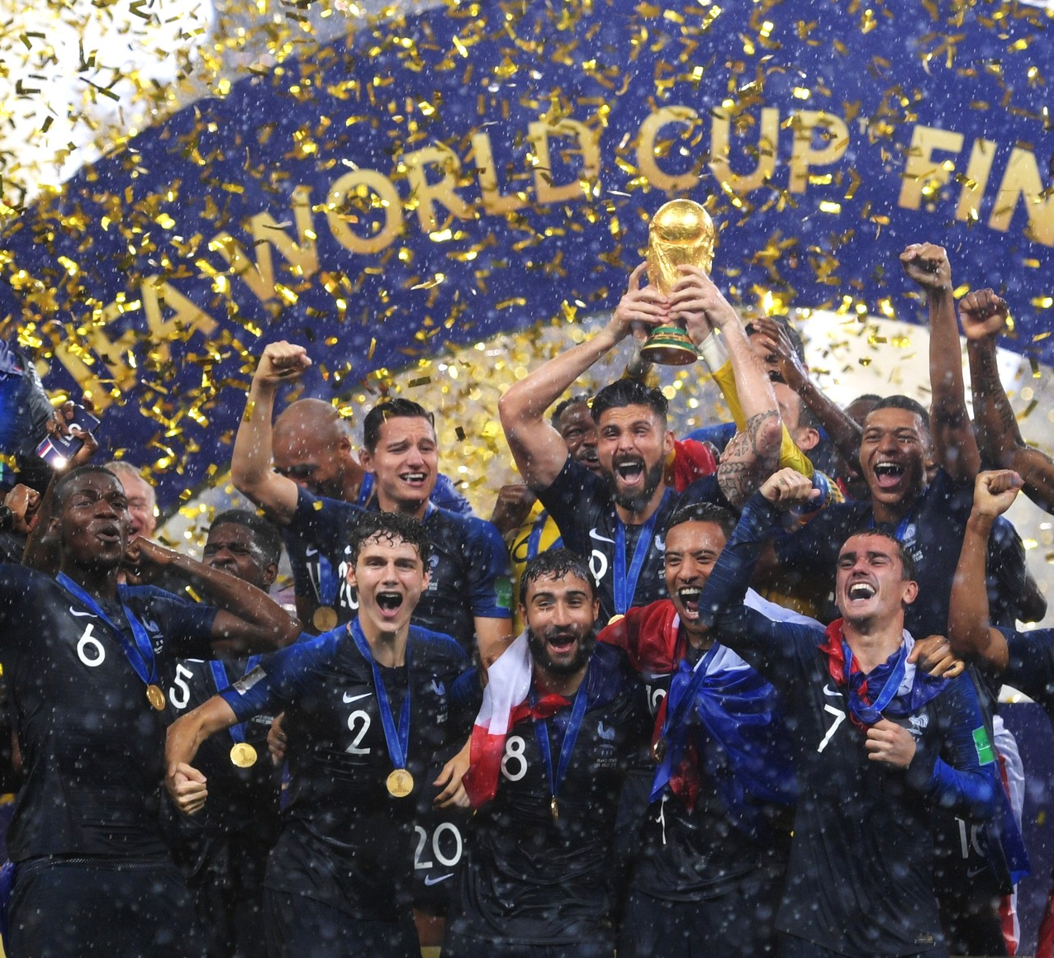
Table of Contents
Introduction
Hypothesis
Feature Engineering
Model Training
Results

Slide 3

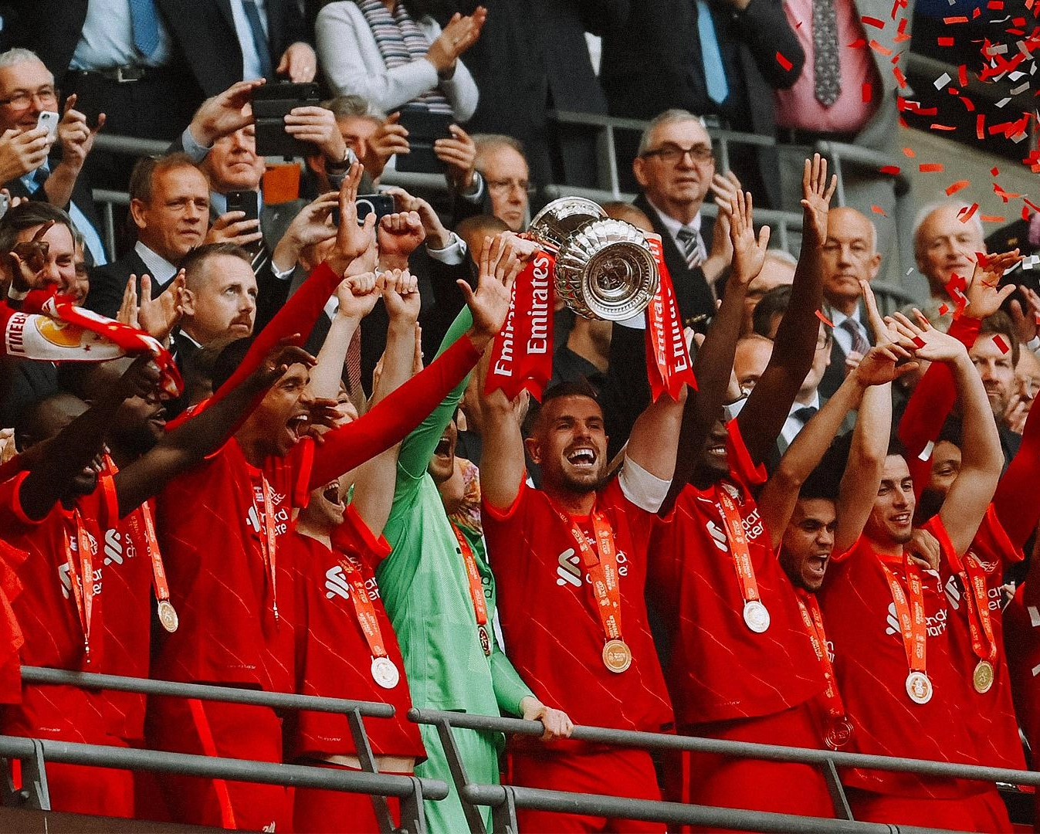
Introduction
Deeper levels of analysis required
Dependent on the roles and players themselves
Based on player’s past performance individually and as a team
Broad + specific details impactful

Slide 4

Hypothesis
Predicting the outcome of future matches based on past
home favorable by 15 to 20%
more wins and losses than draws by 10-14%
More draws in higher leagues
Notes:
I predict that the outcomes of games favor the home team more, usually if they have a higher team rating the larger the home team rating goes up. If the opposition rating is much higher than the home team, there’s no impact to the loss. I believe the draws will be less than either win and loss percentages within the games, and that the teams in the higher leagues have more draws than the teams in the lower leagues.

Slide 5

1. Feature Engineering
Performing to simplify data transformation as well as providing a more enhanced model accuracy
For missing values, determine the range and possible values
Includes:
Coaches, performance history, team rating, number of goals
Notes:
I utilized feature engineering to find and observe specific features in a more organized manner so I can observe the necessary information that would provide me some indication towards the goal of this project.
One thing is to make sure with all data sets whether there are missing values, and through looking at the specific features that is missing values what sort of values to assign them. For example, I would have to assign whether they are playing a game for a cup as 0 that game if they aren’t since the competitive aspect is not present likely within the players and coaches in comparison to a regular season game, and fill their team rating with the mean of their previous performance ratings.
Some key features will be the home and away team for the game, the specific league, the coaches, both team’s ratings, and the history of their performance withi the respective leagues and the average amount of goals that’s been scored and conceded as those reflect the offensive and defensive performances of the teams in their previous games.
In our heatmap of hom team coaches, we see that there is a stronger correlation compared to a heatmap of the home team history of goals for 10 games because for 10 games they play different teams and so they play against different teams which only rely on their offensive performance and luck, whereas coaches wouldn’t be swapped every game so often constantly

Slide 6

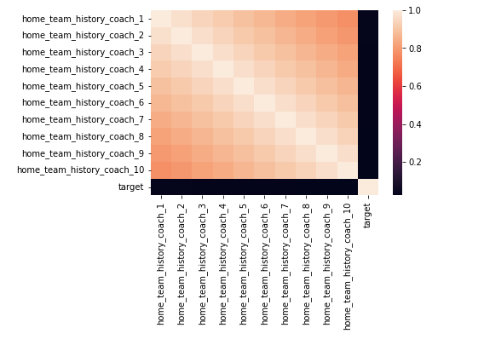
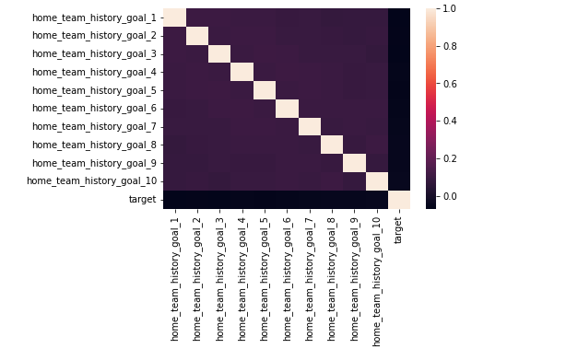
Feature Engineering Continued

Slide 7

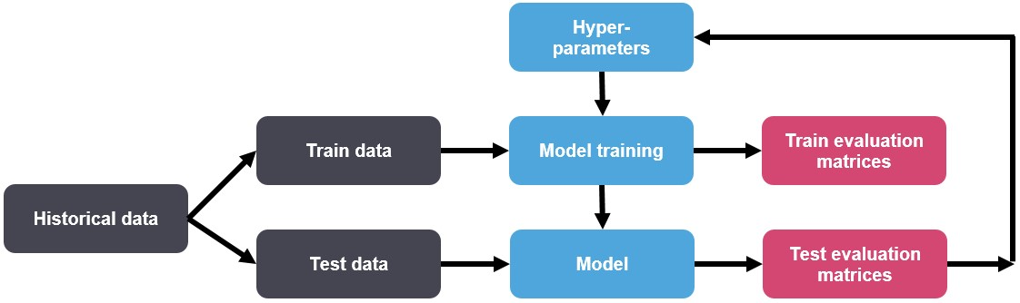
Model Training
Splitting train_df into training and test data
Trains the model
Verifies the generalized performance of the model
Hyperparameter tuning
Boosting
Notes:
Data partitioning is normally used in supervised learning techniques in data mining where a predictive model is chosen from a set of models, using their performance on the training set as the validation of choice
Model is partitioned via splitting our data frame (table of data split into rows and columns) into training data and test data
We will use hyperparameter tuning alongside looking through model parameters and train them in order to find the best fit for our models

Slide 8

Hyperparameter Tuning
More representative fit and higher data accuracy
Higher quality and accurate model evaluations
Cross validation loss of 1012 +/- 0.004
Notes:
In order to provide a clean, representative model architecture, we observe the data provided to control the learning of the model throughout the process of an ML algorithmThe fit of the model is more representative and accurate of the data by tuning the hyperparameters which is done by searching through hyperparameter values
Model evaluations are better as there are more accurate values and better performance of the classification as a result
We also perform a k-fold cross-validation and reach a cross-validation loss of 1.012 +/- 0.004
Our test loss is 1.00823
Our train loss is 0.97869186
This means that our model requires more tuning and adjustments in order to have a much more accurate evaluation of future performances of teams

Slide 9

Boosting
Used LightGBM
Followed by evaluating model and average the total predictions
Test loss is similar to train loss
classification gets similarly accurate values
prediction values similar
Notes:
Used LightGBM for data due to simple implantation and to provide a faster and more accurate result derived from model in comparison to using other boosting algorithms like xgboost
LightGBm, unlike its counterpart boosting algorithms, generates multiple weak learners and take the combined predictions to form a stronger version during training phase
Test loss is similar to train loss so we know that the classification has been able to derive similarly accurate values and keep the prediction values similar

Slide 10

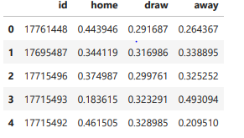
Results
Teams perform better at a home game
Condition of stadium
Scoring concept of soccer
Different leagues equates to different skill and situations
Opponent rating only corrected about half of the games correctly
Notes:
I was able to create a table with probability of teams in terms of winning home/away or drawing in accordance with their team id’s
Well over 60% of the teams performed better at a home game compared to playing at an away game when looking at their past performance and rating
This could be well due to the condition of the where they are playing due to weather and audience
The scoring differential wasn’t too huge amongst the teams and there were many draws that ended up being even greater than the home wins and away wins for some teams. This may be due to the scoring of soccer, where even 1 goal is incredibly difficult to score in a game. The leagues observed were some of the best leagues in the world, including the premier league, the laliga, Bundesliga, series a, MLS, and a few others, thus defense and penalty situations, the higher leagues ending games on more draws are more critical in the higher leagues
The predictions for the accuracy of probability for determining wins and losses was not the highest at a .51, so it wil lcome down to tuning and effectively creating a better model to provide more accurate predictions nad descriptions as to hwo games will pan out in the length of a season hopefully for the teams.

Slide 11

Thank You
Any Questions?
Email: richardchadori@gmail.com
Phone Number: 425-289-6616

